Slide 1

Data Storage and Data Processing Architectures
The difficulty is in the choice
George Moore, 1900

Slide 2
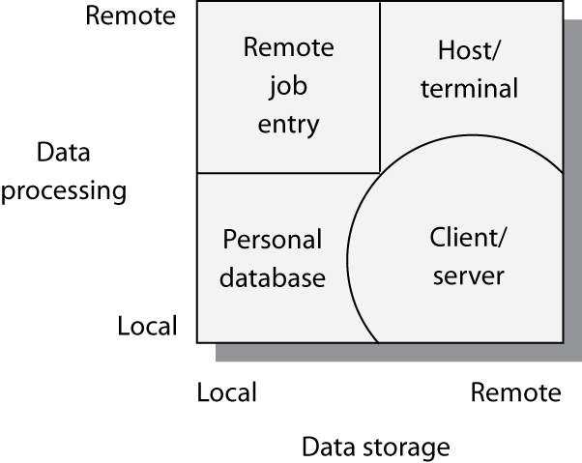
Architectures

Slide 3
Remote job entry
Local storage
  Often cheaper
  Maybe more secure
Remote processing
Useful when a personal computer is:
  too slow
  has insufficient memory
  software is not available
Some local processing
  Data preparation

Slide 4
Personal database
Local storage and processing
Advantages
  Personal computers are cheap
  Greater control
  Friendlier interface
Disadvantages
  Replication of applications and data
  Difficult to share data
  Security and integrity are lower
  Disposable systems
  Misdirection of attention and resources

Slide 5
Host/terminal
Remote storage and processing
Associated with mainframe computers
All shared resources are managed by the host (server)

Slide 6
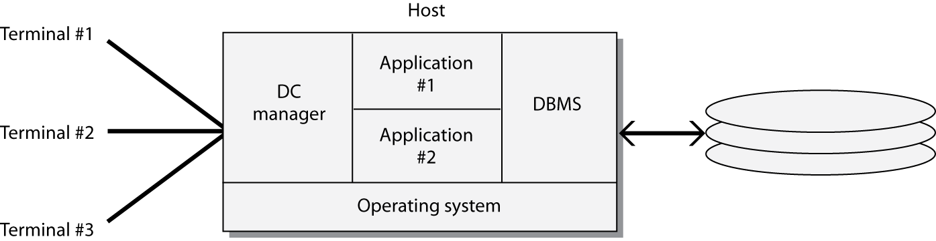
Host/terminal

Slide 7
LAN architectures
A LAN connects computers within a geographic area
Transfer speeds of up to 1,000 Mbits/sec
Permits sharing of devices
A server is a computer that provides and controls access to a shareable resource

Slide 8
File/server
A central data store for users attached to a LAN
Files are stored on a file/server
Data is processing on users’ personal computer
Entire files are transmitted on the LAN
Can result in heavy LAN traffic
File is locked when retrieved for update
Limited to small files and low demand

Slide 9
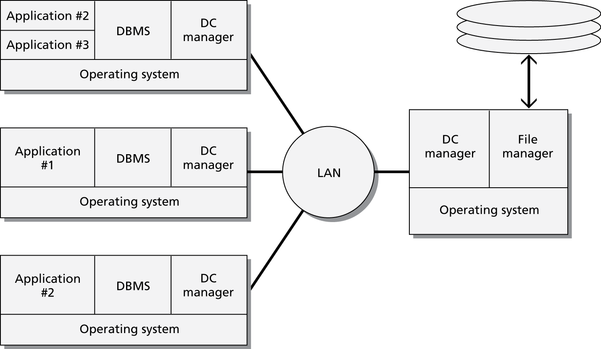
File/server

Slide 10
DBMS/server
A server runs a DBMS
Only necessary records are transmitted on the LAN
Less LAN traffic than file/server
Back-end program on the server handles retrieval
Front-end program on the client handles processing and presentation
More sharing of processing than file/server

Slide 11
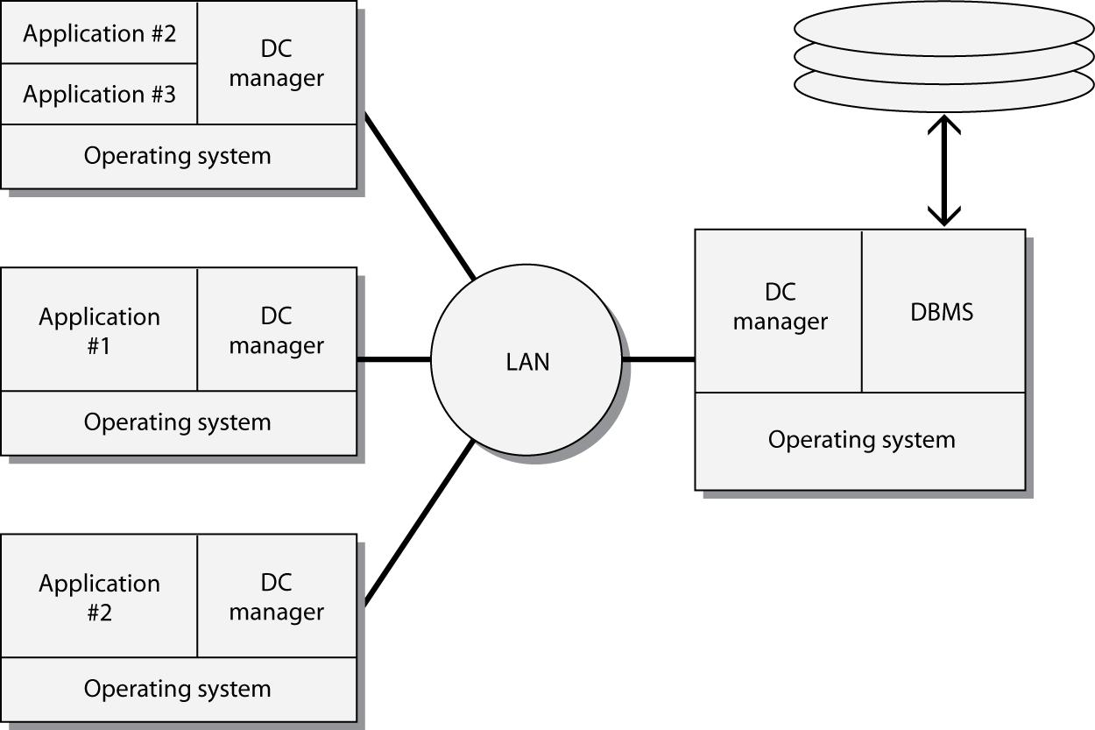
DBMS/server

Slide 12
Client/server
File/server and DBMS/server are examples of client/server
Objective is to reduce processing costs by splitting processing between clients and the server
Client is typically a Web browser
Savings
  Ease of use / fewer errors
  Less training

Slide 13
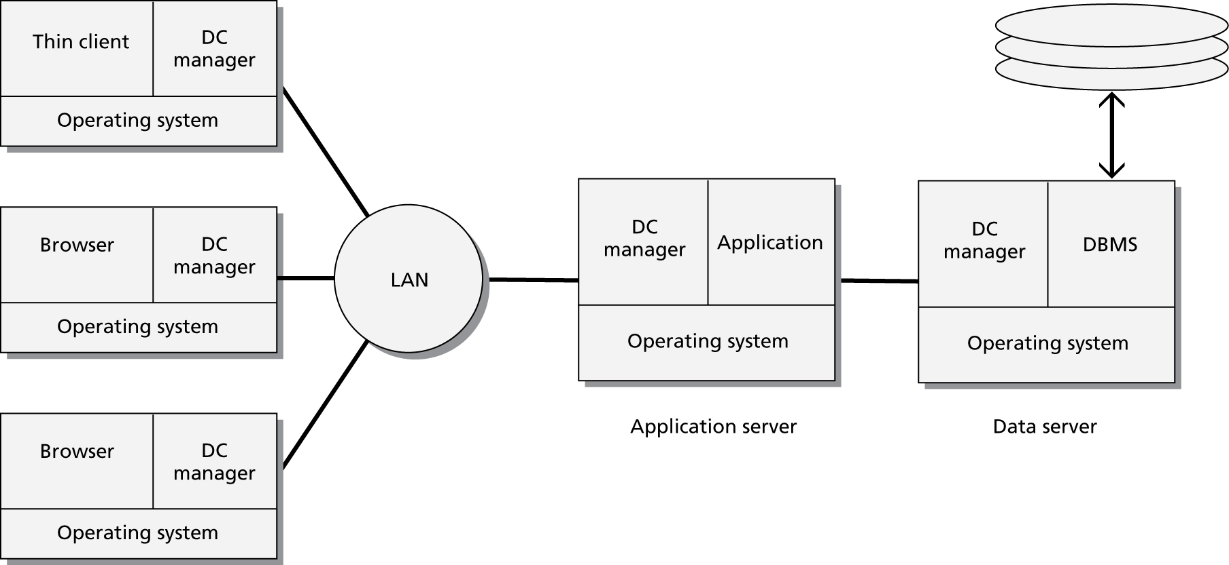
Client/Server - 2nd Generation

Slide 14
Three-tier model
Clients
  Browser
Application servers
  Mainly J2EE compliant
Data servers
  Mainly relational database

Slide 15
Thick and thin clients
Type of client | Thick | Thin
Technology | LAN | Web
Application logic | Mostly on the client | Mostly on the server
Network load | Medium | Low
Data storage | Server | Server
Server intelligence | Medium | High

Slide 16
Advantages of the three-tier model
Security is higher because logic is on the server
Performance is better
Access to legacy systems and a variety of databases
Easier to implement and maintain

Slide 17
Evolution of client/server computing
Architecture | Description
Two-tier | Processing is split between client and server, which also runs the DBMS.
Three-tier | Client does presentation, processing is done by the server, and the DBMS is on a separate server.
N-tier | Client does presentation. Processing and DBMS can be spread across multiple servers. This is a distributed resources environment.

Slide 18
Distributed database
Communication charges are a key factor in total processing cost
Transmission costs increase with distance
  Local processing saves money
A database can be distributed to reduce communication costs

Slide 19
Distributed database
Database is physically distributed as semi-independent databases
There are communication links between each of the databases
Appears as one database

Slide 20
A hybrid
Architecture evolves
  Old structures cannot be abandoned
  New technologies offer new opportunities
Ideally, the many structures are patched together to provide a seamless view of organizational databases
Distributed database principles apply to this hybrid architecture

Slide 21
Fundamental principles
Transparency
No reliance on a central site
Local autonomy
Continuous operation
Distributed query processing
Distributed transaction processing

Slide 22
Fundamental principles
Replication independence
Fragmentation independence
Hardware independence
Operating system independence
Network independence
DBMS independence
Independence

Slide 23
Distributed database access
Remote Request
Remote Transaction
Distributed Transaction
Distributed Request

Slide 24
Remote Request
A single request to a single remote site
  SELECT * FROM atlserver.bankdb.customer
  WHERE custcode = '12345';

Slide 25
Remote Transaction
Multiple data requests to a single remote site
  BEGIN WORK;
  INSERT INTO atlserver.bankdb.account
  (accnum, acctype)
  VALUES (789, 'C');
  INSERT INTO atlserver.bankdb.cust_acct
  (custnum, accnum)
  VALUES (123, 789);
  COMMIT WORK;

Slide 26

Distributed Transaction
Multiple data requests to multiple sites
  BEGIN WORK;
  UPDATE atlserver.bankdb.employee
  SET empusdretfund = empusdretfund + 1000;
  UPDATE osloserver.bankdb.employee
  SET empkrnretfund = empkrnretfund + 7500;
  COMMIT WORK;
* See notes
Notes:
The example in the 4th edition is a distributed request rather than a distributed transaction because the request is accessing multiple sites

Slide 27
Distributed Request
Multiple requests to multiple sites
Each request can access multiple sites
    BEGIN WORK;
    INSERT INTO osloserver.bankdb.employee
    (empcode, emplname, …)
    SELECT empcode, emplname, …
    FROM atlserver.bankdb.employee
    WHERE empcode = 123;
    DELETE FROM atlserver.bankdb.employee
    WHERE empcode = 123;
    COMMIT WORK;
Notes:
This is the example for distributed transaction in the 4th edition, but is a distributed request because the INSERT accesses multiple sites.

Slide 28
Distributed database design
Horizontal Fragmentation
Vertical Fragmentation
Hybrid Fragmentation
Replication

Slide 29
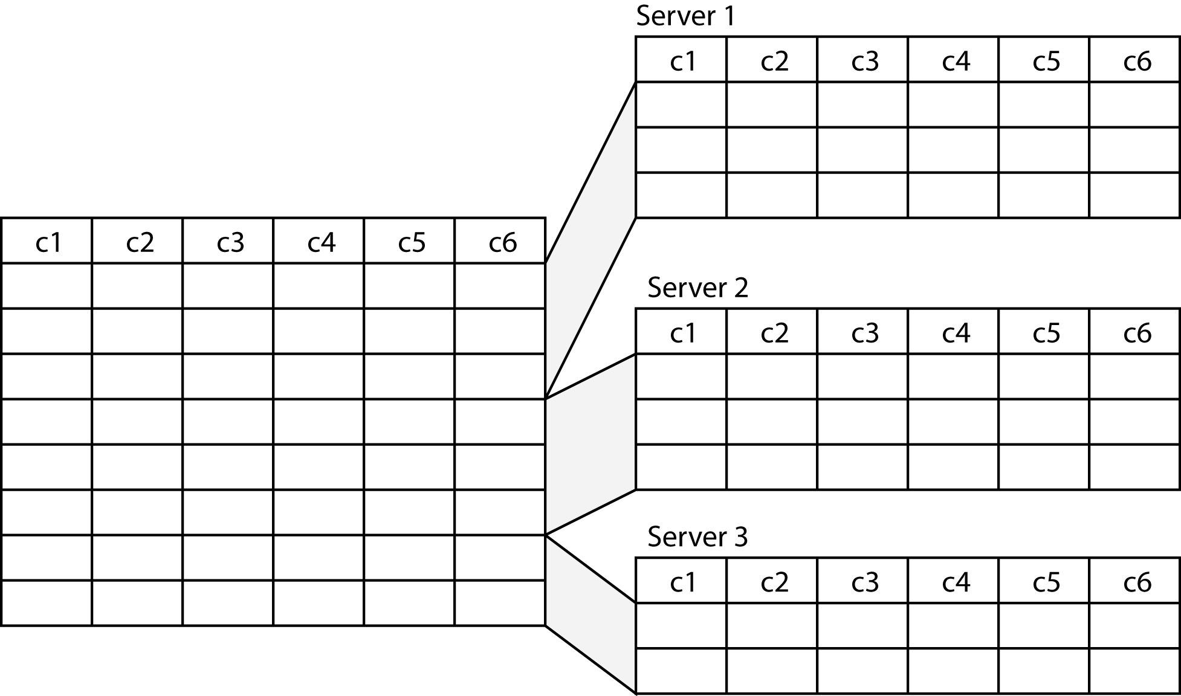
Horizontal fragmentation

Slide 30
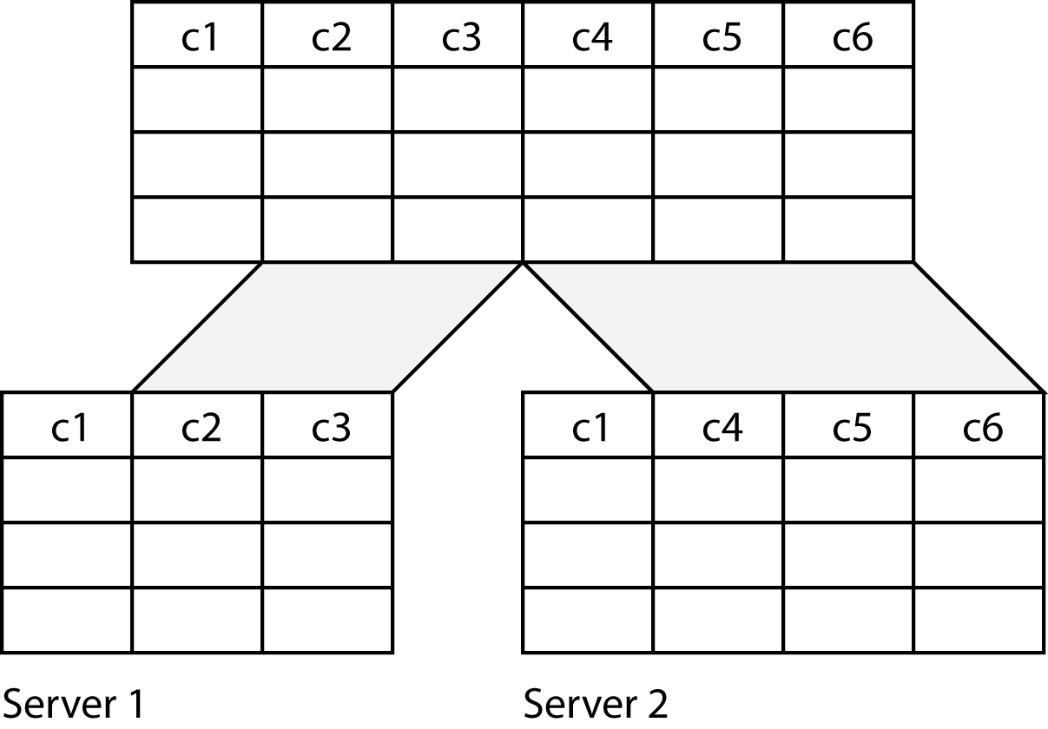
Vertical fragmentation

Slide 31
Replication
Full replication
  Tables are duplicated at each of the sites
  Increased data integrity
  Faster processing
  More expensive
Partial replication
  Indexes replicated
  Faster querying
  Retrieval from the remote database

Slide 32
Keypoints
There are four basic data processing architectures
N-tier client/server dominates today
Databases can be distributed to lower communication costs and improve response time

